Slide 1
Single-Source Shortest Paths
Chaklam Silpasuwanchai

Slide 2
Readings
Chapter 24, Single-Source Shortest Paths, Cormen et al. (2009). Introduction to Algorithms, Third Edition (3rd ed.). The MIT Press.
Chapter 6, Weighted Graph Algorithms, Skiena, S. S. (2008). The Algorithm Design Manual, Second Edition (2nd ed.). Springer Science & Business Media.
Chapter 13, Graphs, Robert Lafore. (2002.) Data Structures and Algorithms in Java, Second Edition (2nd ed.). Sams, Indianapolis, IN, USA.
Douglas Wilhelm Harder, Waterloo University - https://ece.uwaterloo.ca/~dwharder/aads/

Slide 3
Outline
Shortest Paths
Dijkstra’s algorithm
Bellman Ford’s algorithm

Slide 4
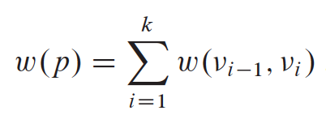
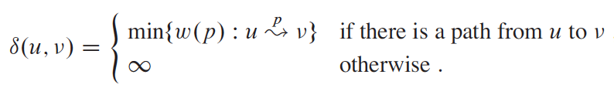
Shortest Paths
Consider a digraph G = (V, E) with edge-weight function w : E → ℝ. The weight of path p = v₀ → v₁ → ... → v_{k} is defined to be
We define the shortest path weight 𝛿(u,v) from u to v

Slide 5
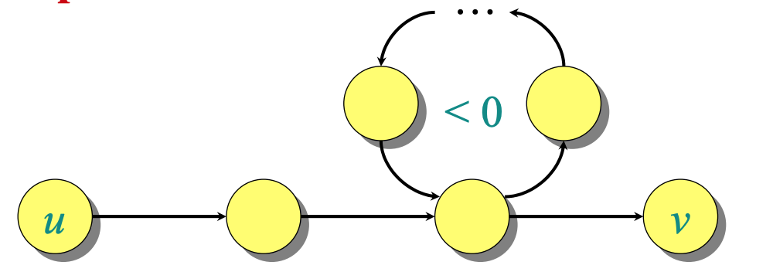
Shortest Paths
Shortest path cannot contain a negative-weight nor positive-weight cycle
Thus only 0-weight cycles, i.e., they are simple paths
In any acyclic path in graph G = (V, E), there contains at most V vertices, it also contains at most V - 1 edges. Thus shortest path is at most V - 1 edges

Slide 6
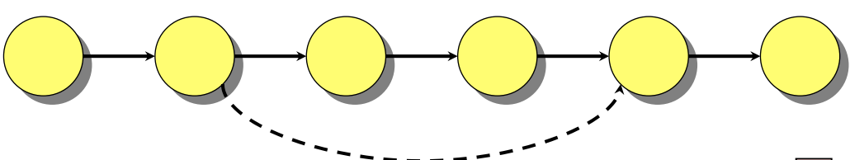
Shortest Paths
Theorem: A subpath of a shortest path is a shortest path
Proof: Simply cut and paste

Slide 7
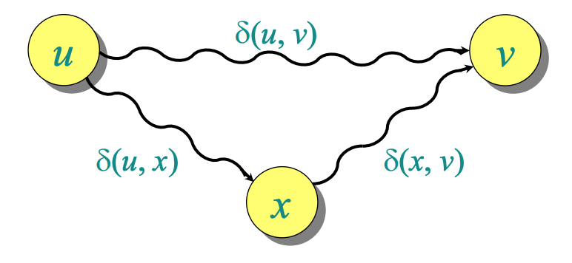
Shortest Paths
Theorem - Triangle Equality
For all u, v, x ∈ V, we have δ(u, v) ≤ δ(u, x) + δ(x, v)

Slide 8
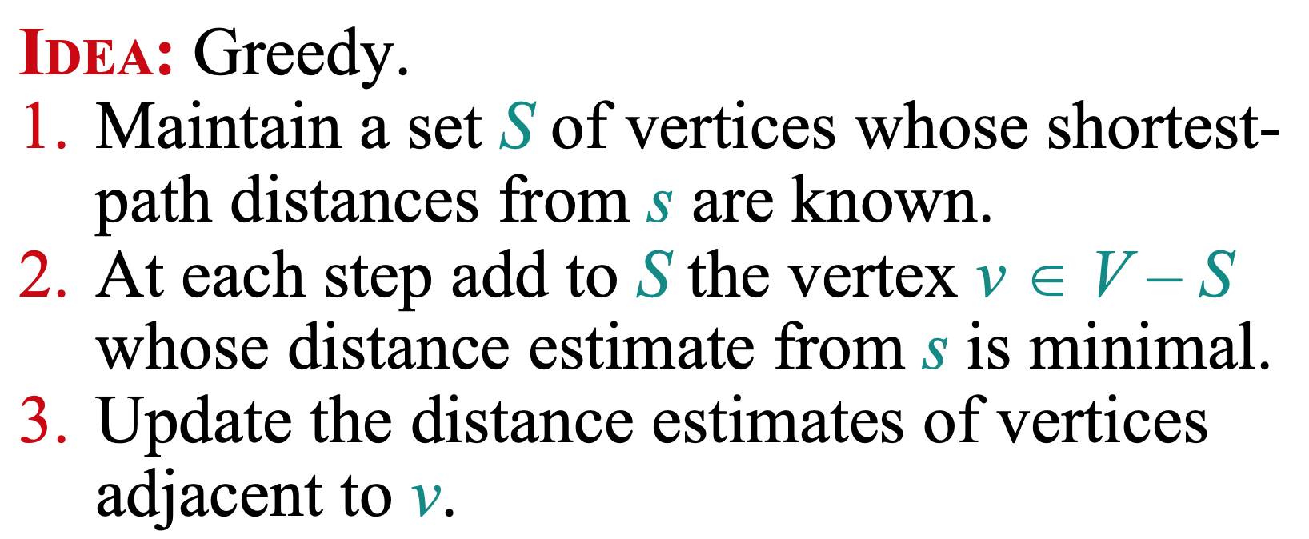
Dijkstra’s algorithm

Slide 9
Dijkstra’s algorithm
Problem. From a given source vertex s ∈ V, find the shortest-path weights δ(s, v) for all v ∈ V. If all edge weights w(u, v) are nonnegative, all shortest-path weights must exist.
Definition:
S → set of vertices whose shortest paths are determined
V - {s} → remaining vertices whose shortest paths are yet to determine (maintained by a min priority queue Q)
d{s} → distance from s to s = 0
d{v} → distance from s to v where v ∈ {V - s }
v.𝜋 → previous (this will help us trace back)

Slide 10
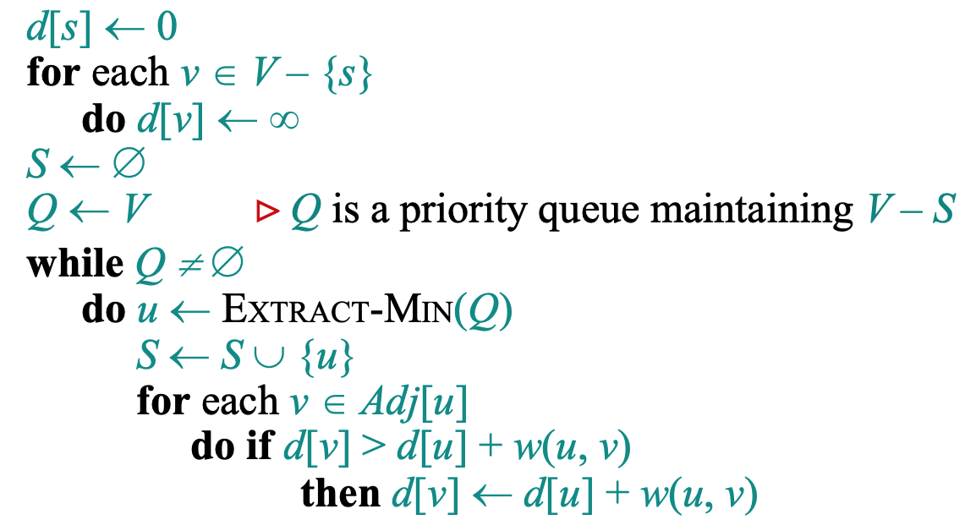
Pseudocode
v.𝜋 ← u

Slide 11
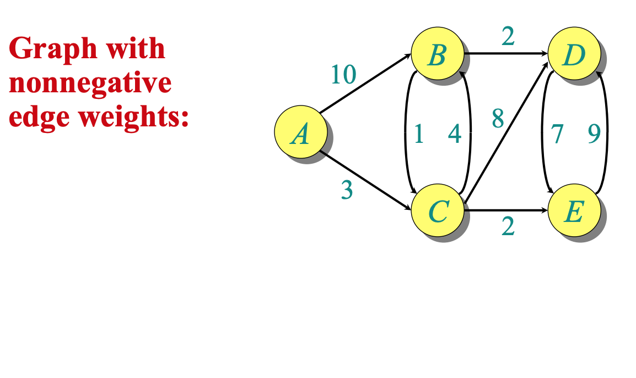
Example

Slide 12
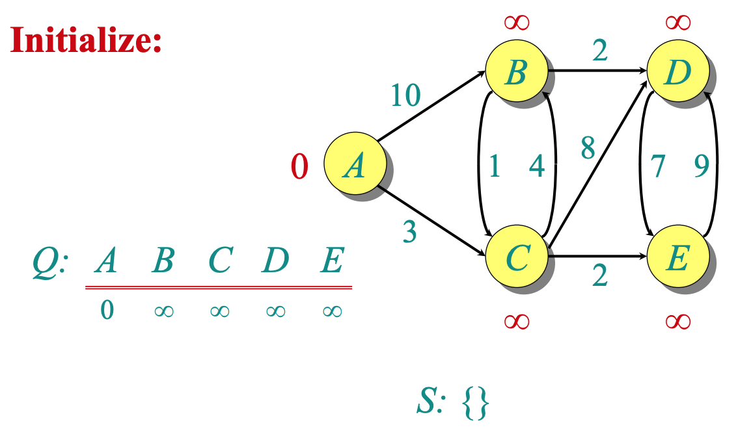
Example

Slide 13
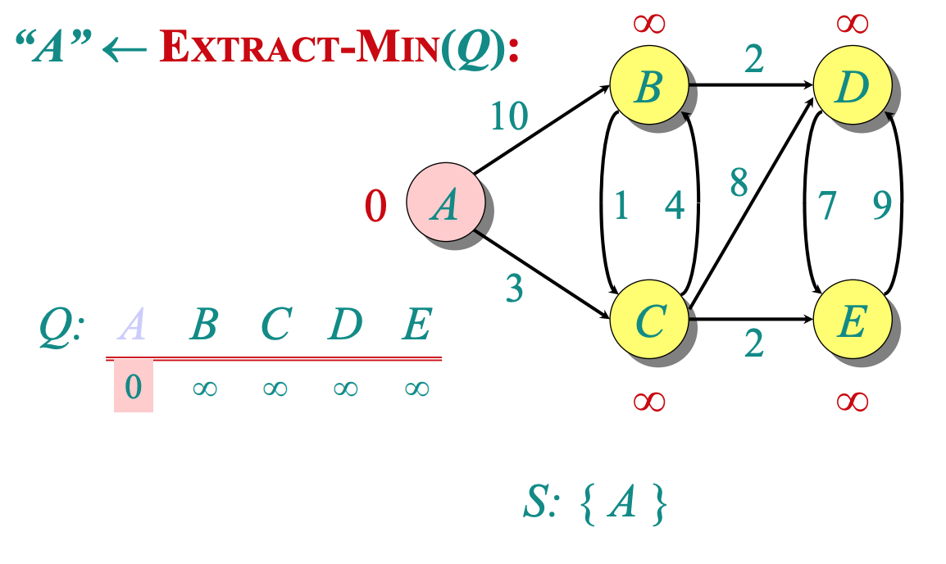
Example

Slide 14
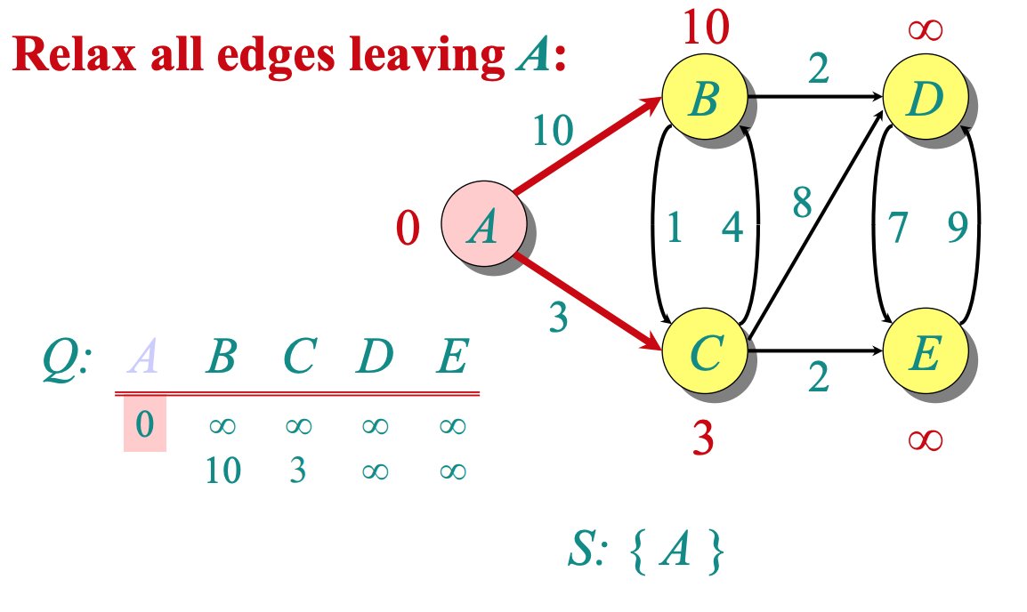
Example

Slide 15
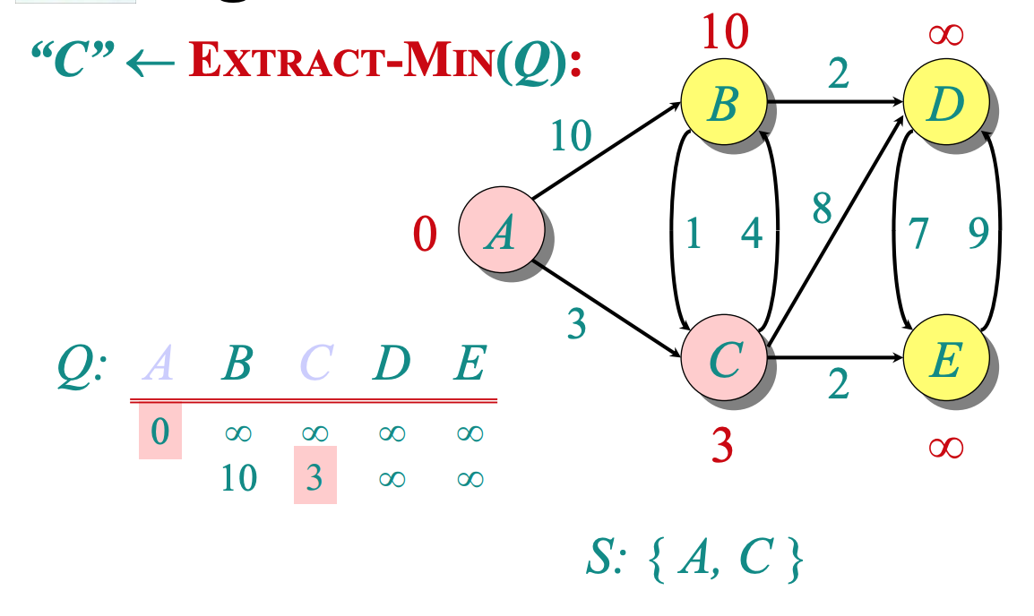
Example

Slide 16
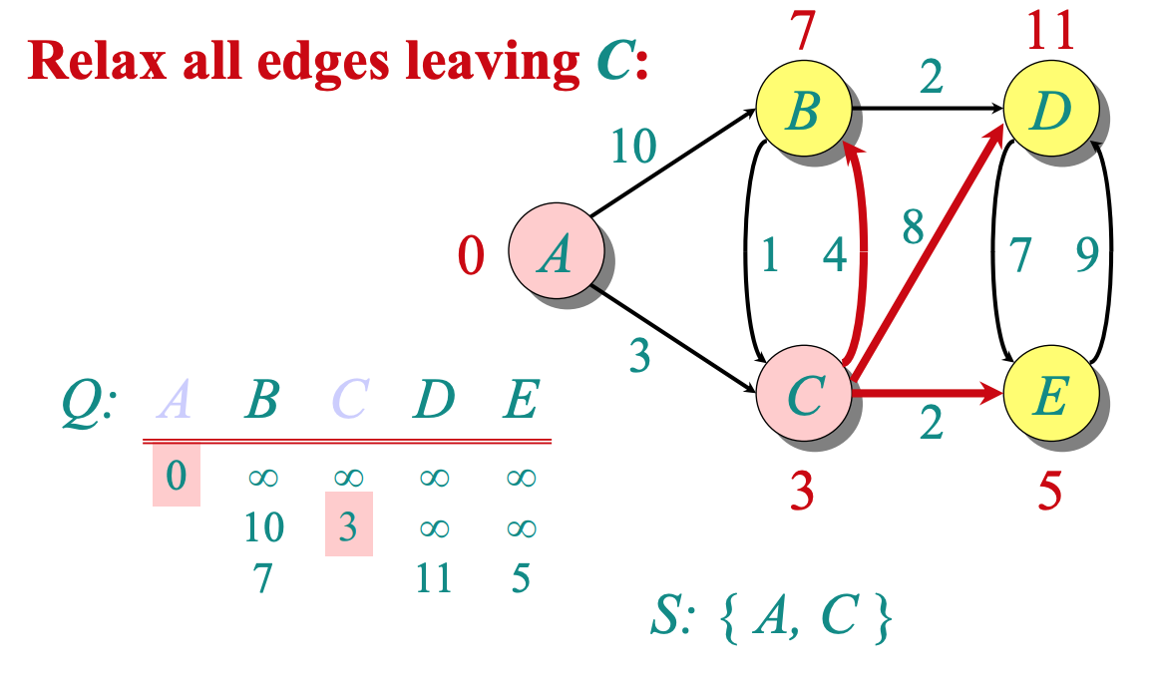
Example

Slide 17
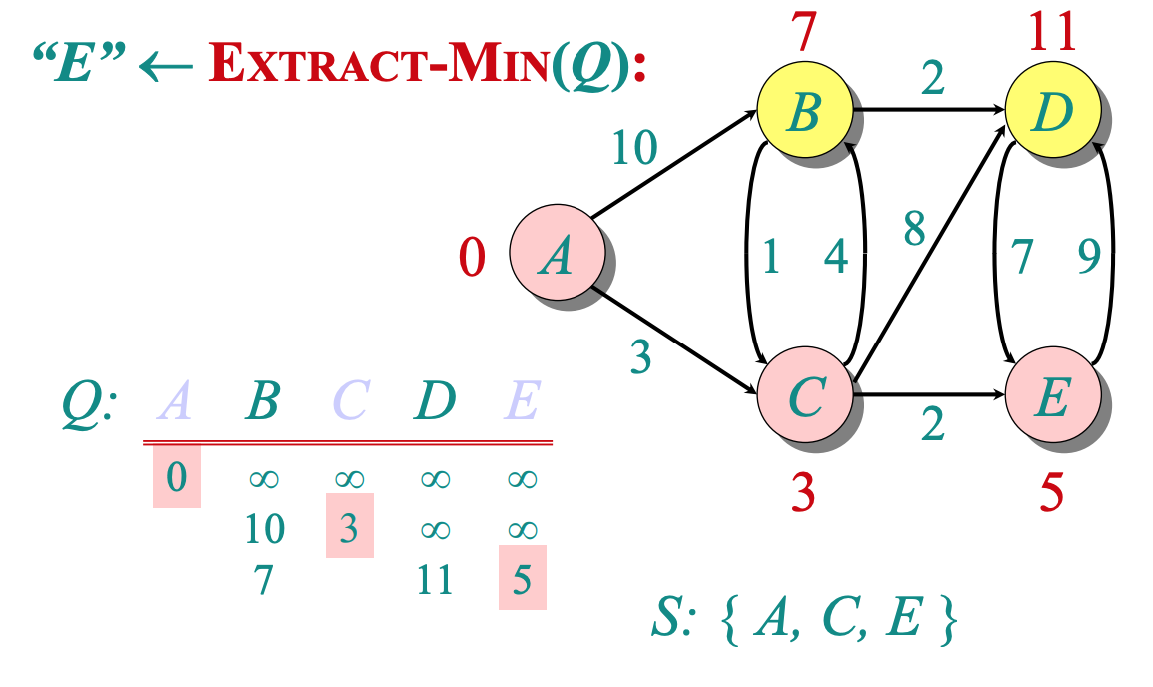
Example

Slide 18
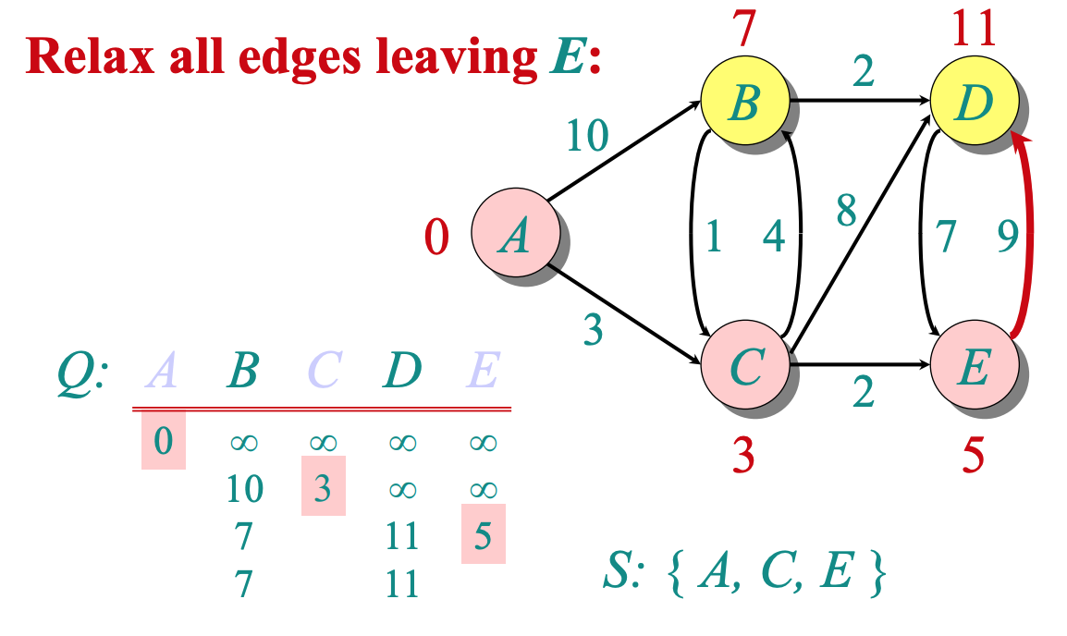
Example

Slide 19
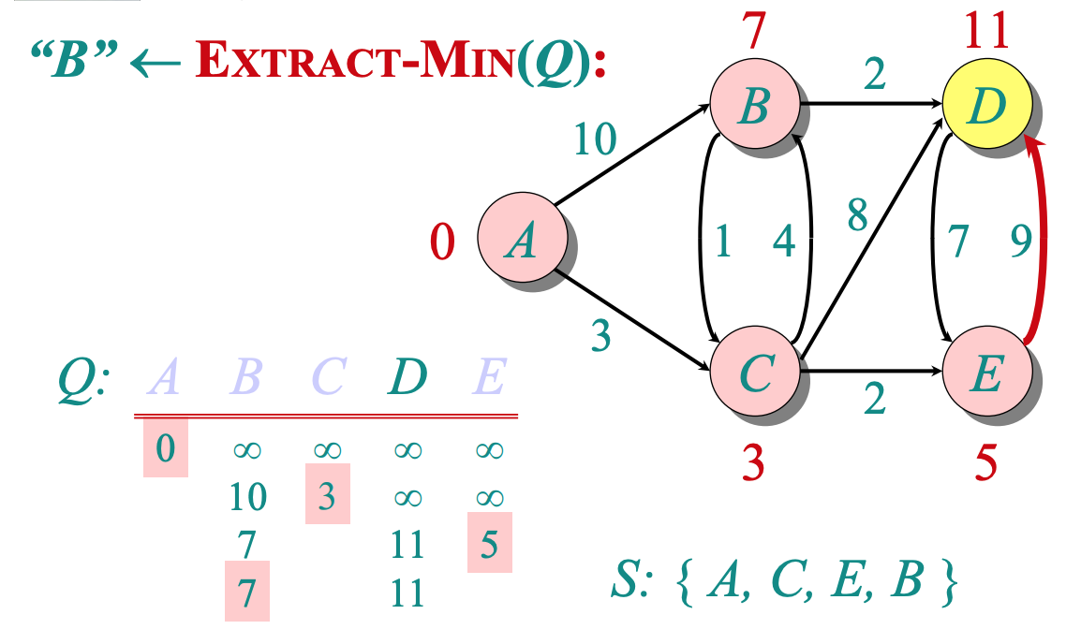
Example

Slide 20
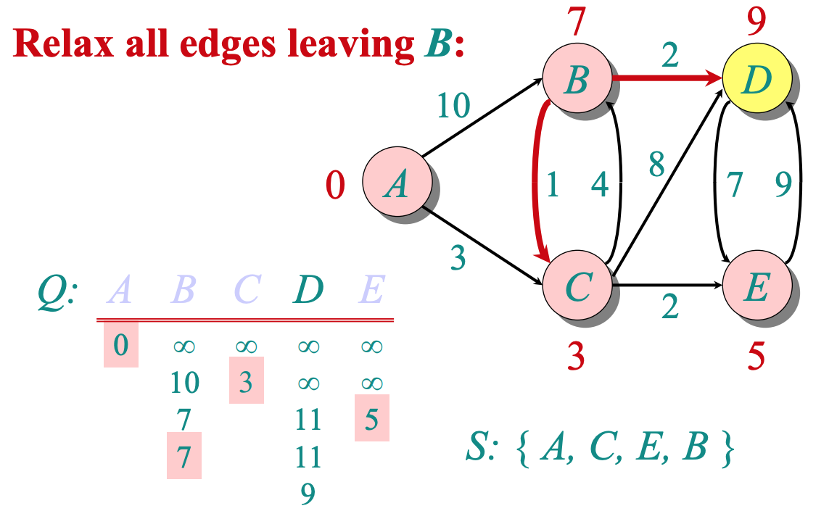
Example

Slide 21
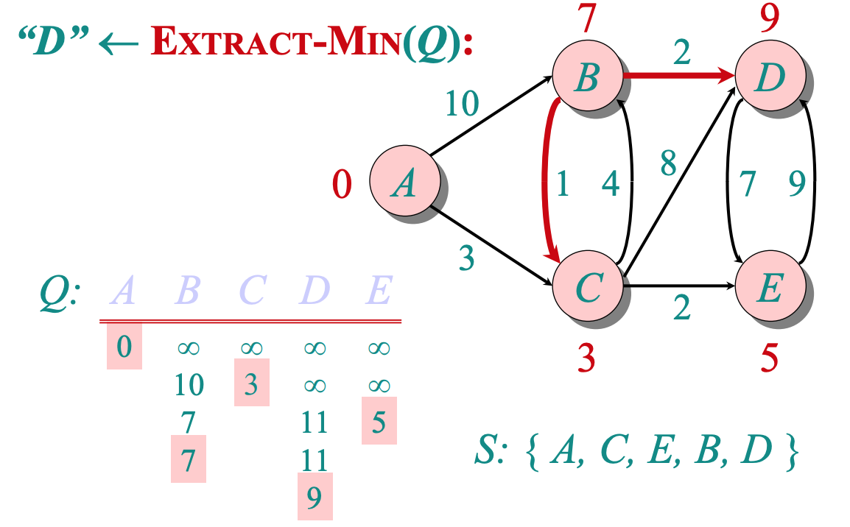
Example

Slide 22
Complexity
Θ(|V|) * T_{EXTRACT-MIN}
Θ(|E|) * T_{RELAX}
v.𝜋 ← u

Slide 23
Complexity
Θ(|V|) * T_{EXTRACT-MIN} + Θ(|E|) * T_{RELAX}
 | T_{EXTRACT-MIN} | T_{RELAX} | Total
Array | O(V) | O(1) | O(V²)
Binary Heap | O(log V) | O(log V) | O(E log V) since it is reasonable that E > V
Fibonacci Heap | O(log V) | O(1) | O(V log V + E)

Slide 24
Appendix: Tabular Version
Dijkstra Algorithm
Credit: Douglas Wilhelm Harder, Waterloo University - https://ece.uwaterloo.ca/~dwharder/aads/

Slide 25
Tabular version
Start at the node you want to mark as starting point
Mark that node as “visited”
From this node, choose one direct neighbor with shortest path
Mark that neighbor as “visited”
From this neighbor, update whether there is a way to go to other node from starting point with a cheaper cost, if yes, update
Then, from all the neighbors of all visited nodes, choose the neighbor with shortest paths, then repeat 4-5

Slide 26
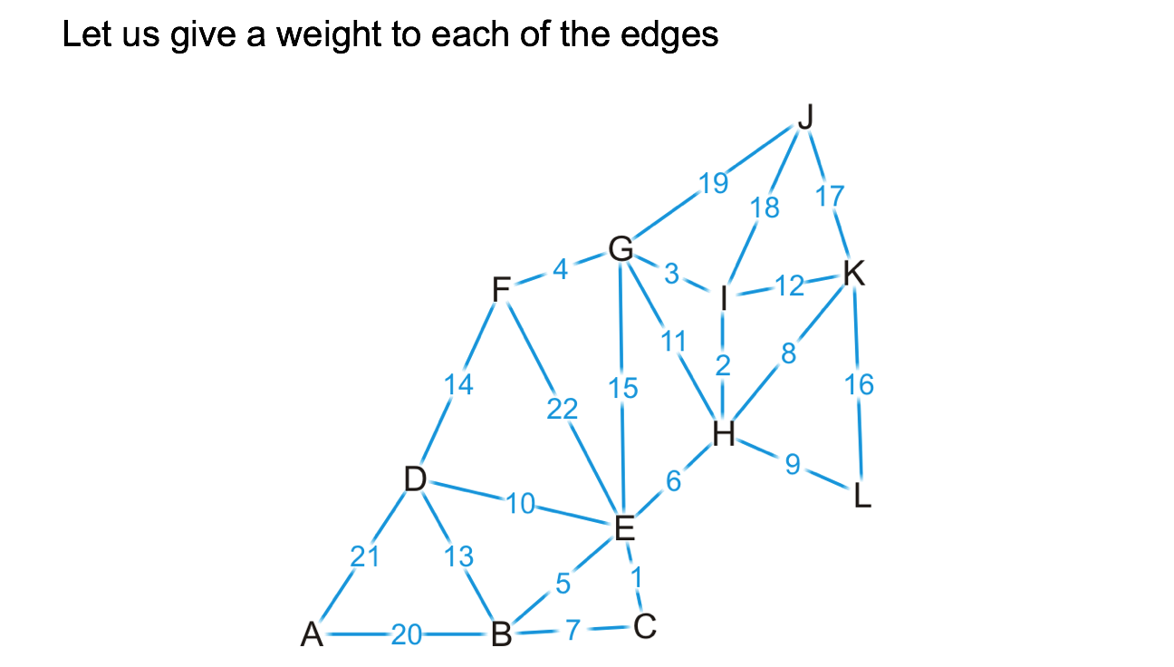
Example
Find the shortest path from K to other region

Slide 27
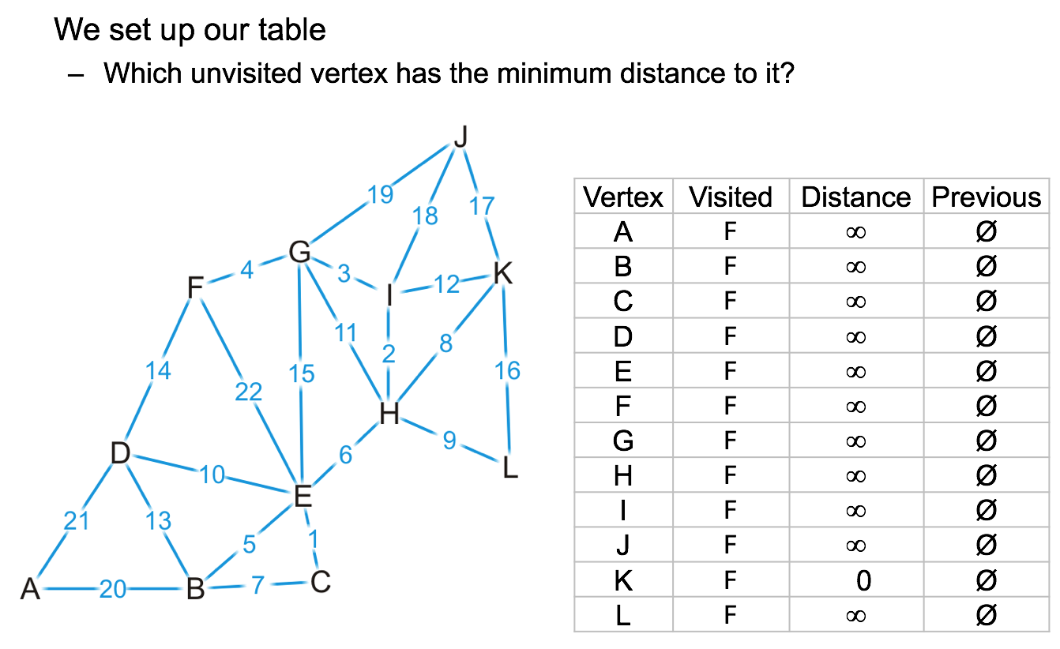
Example

Slide 28
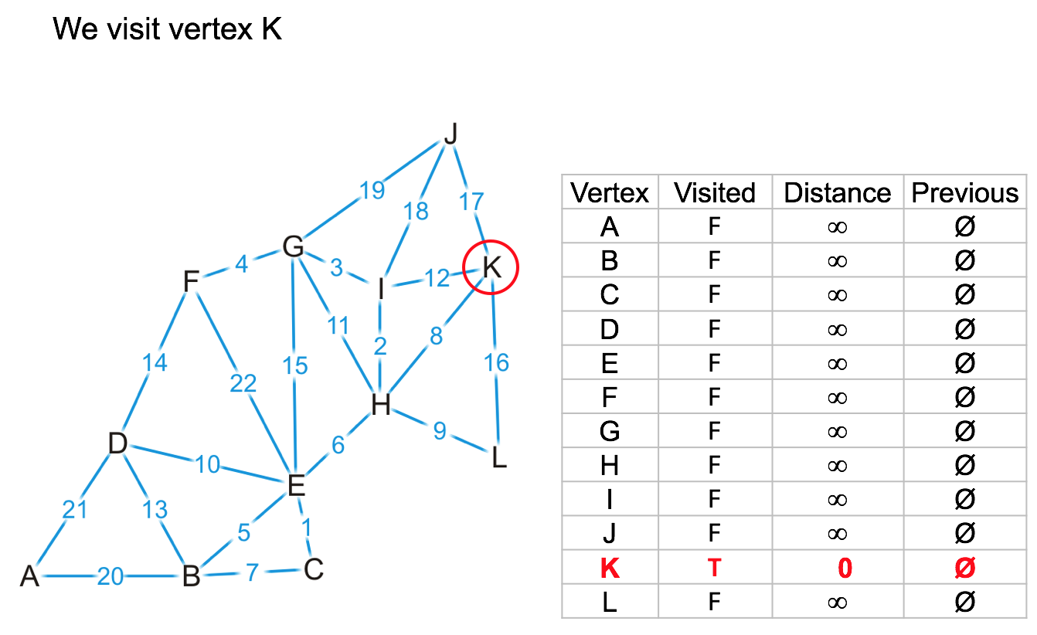
Example

Slide 29
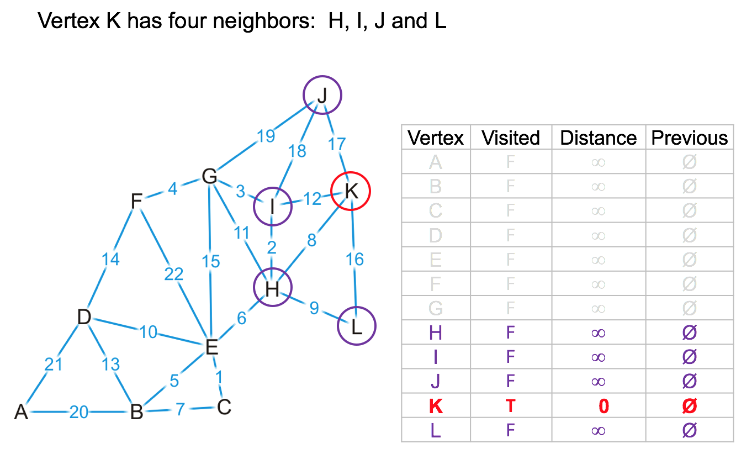
Example

Slide 30
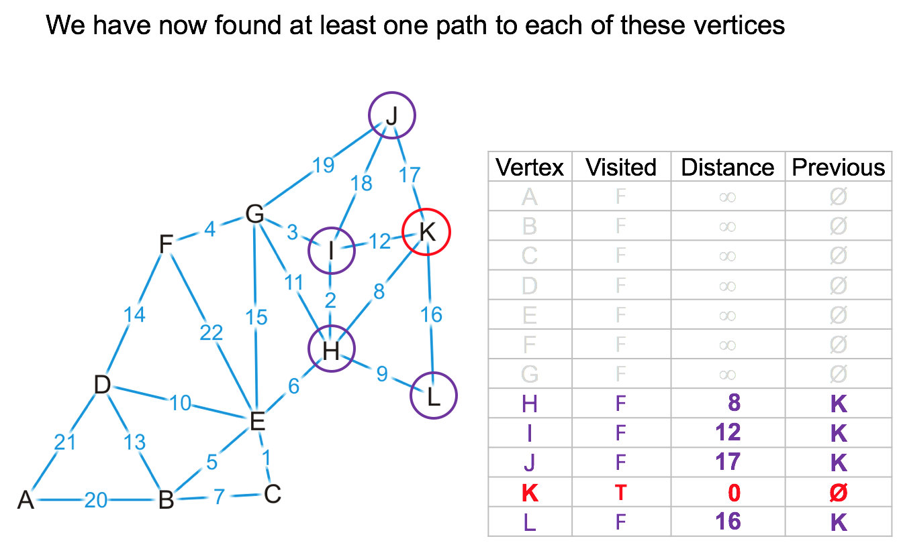
Example

Slide 31

Example

Slide 32
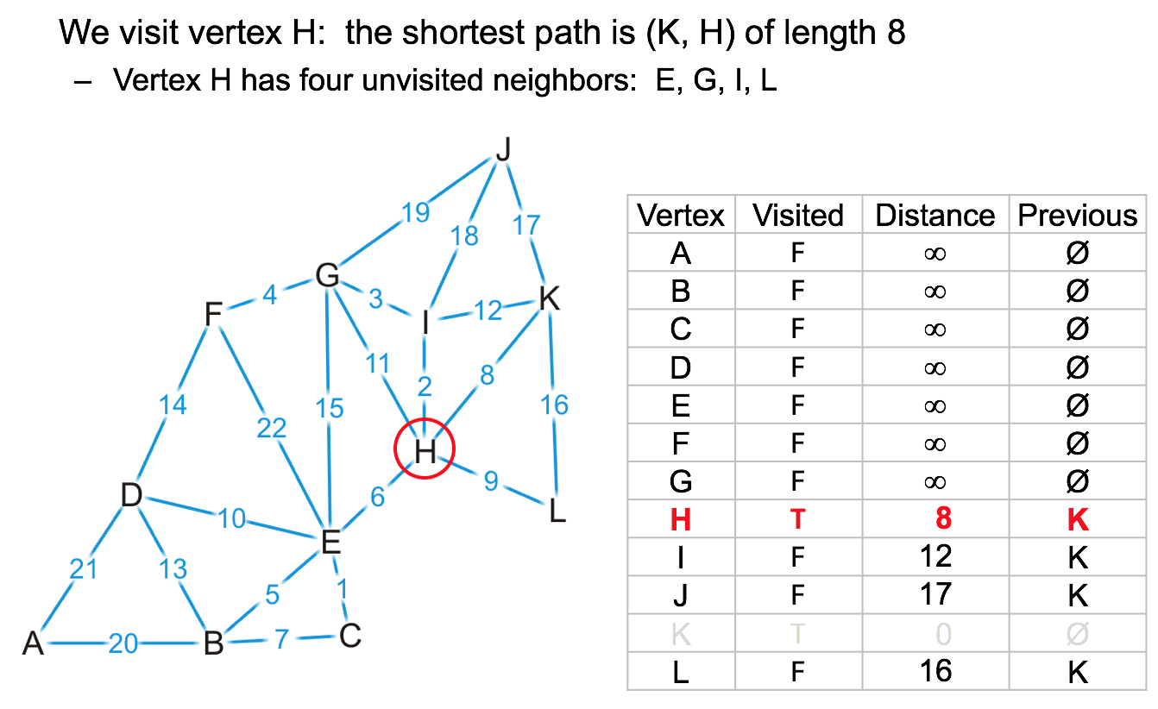
Example

Slide 33
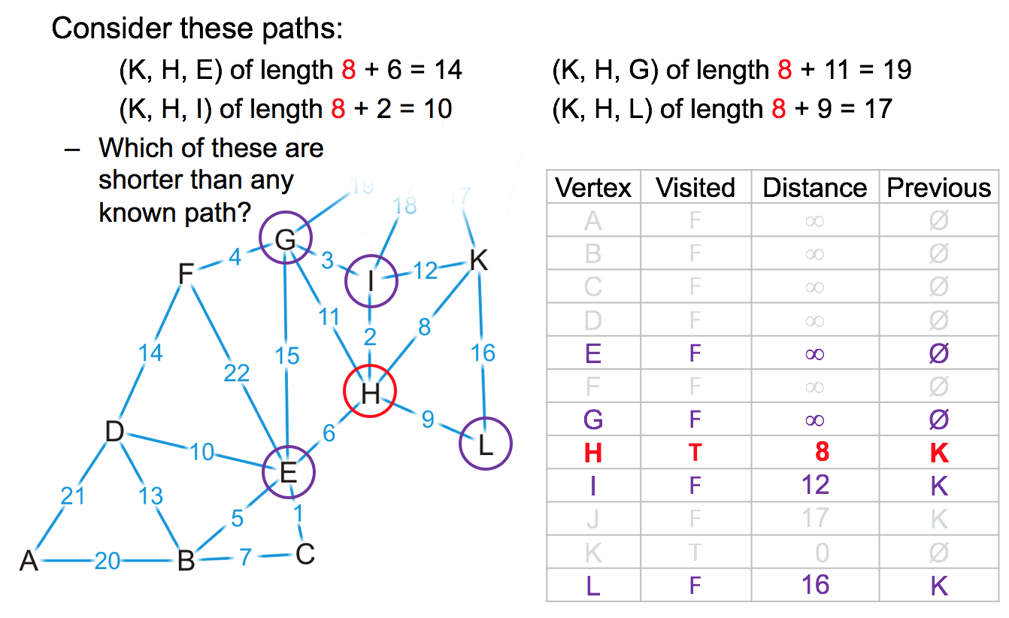
Example

Slide 34
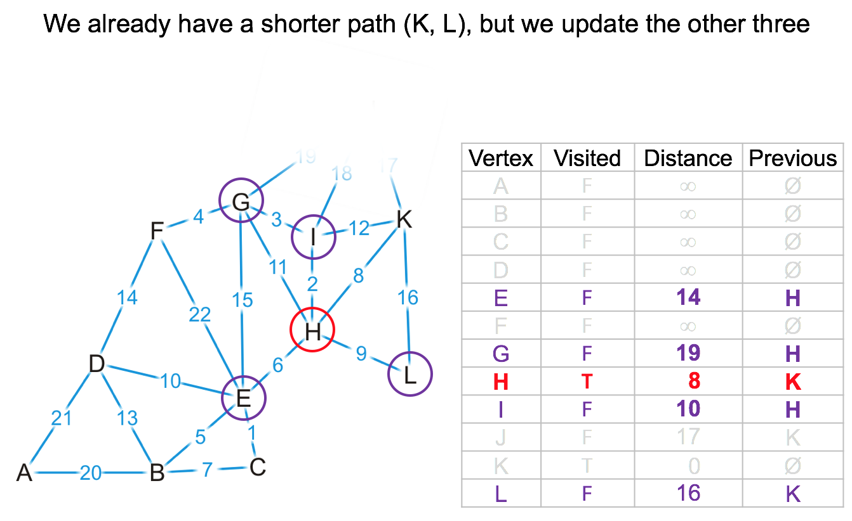
Example

Slide 35

Example

Slide 36
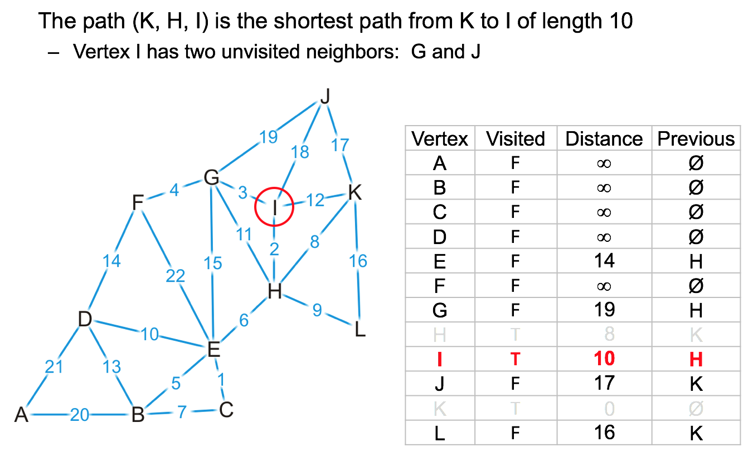
Example

Slide 37
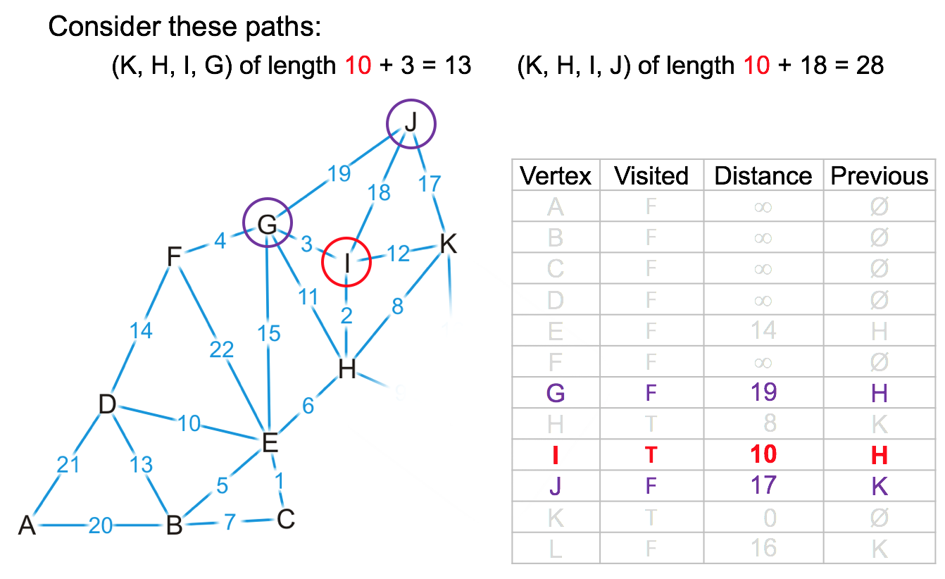
Example

Slide 38
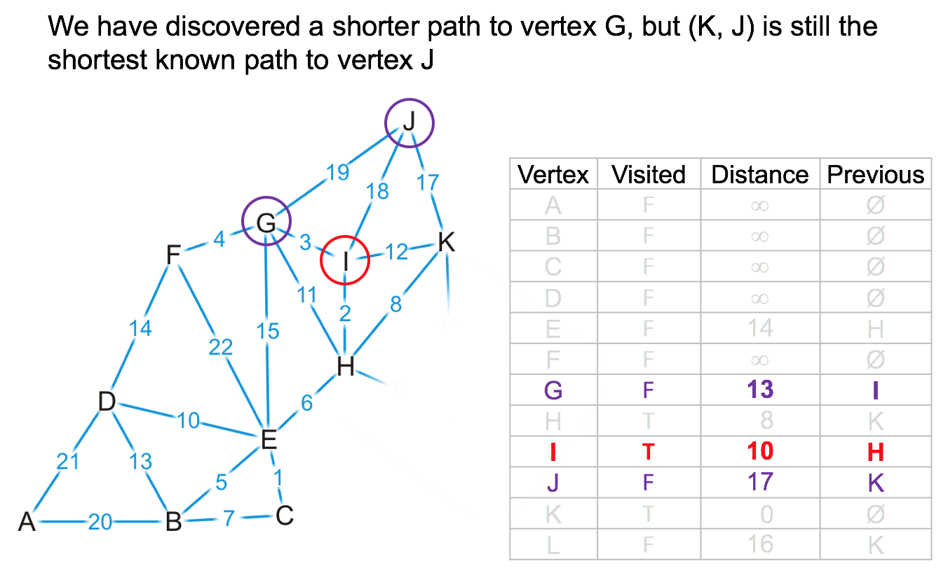
Example

Slide 39

Example

Slide 40
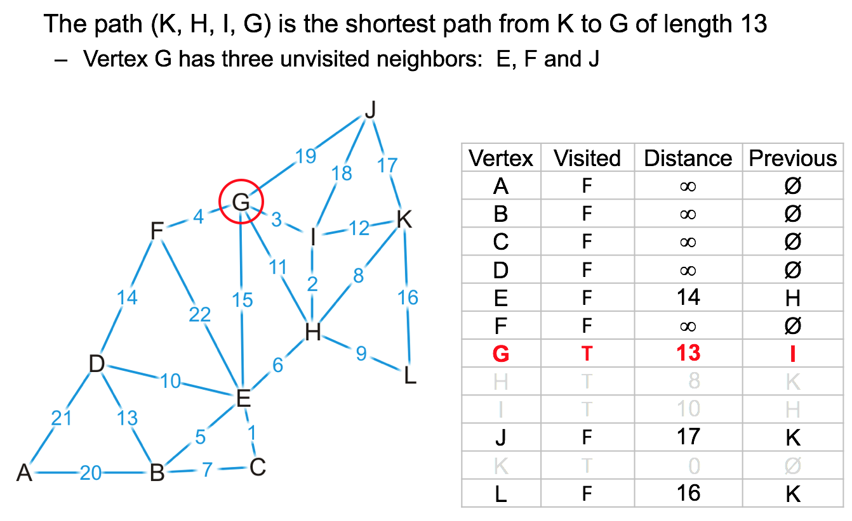
Example

Slide 41
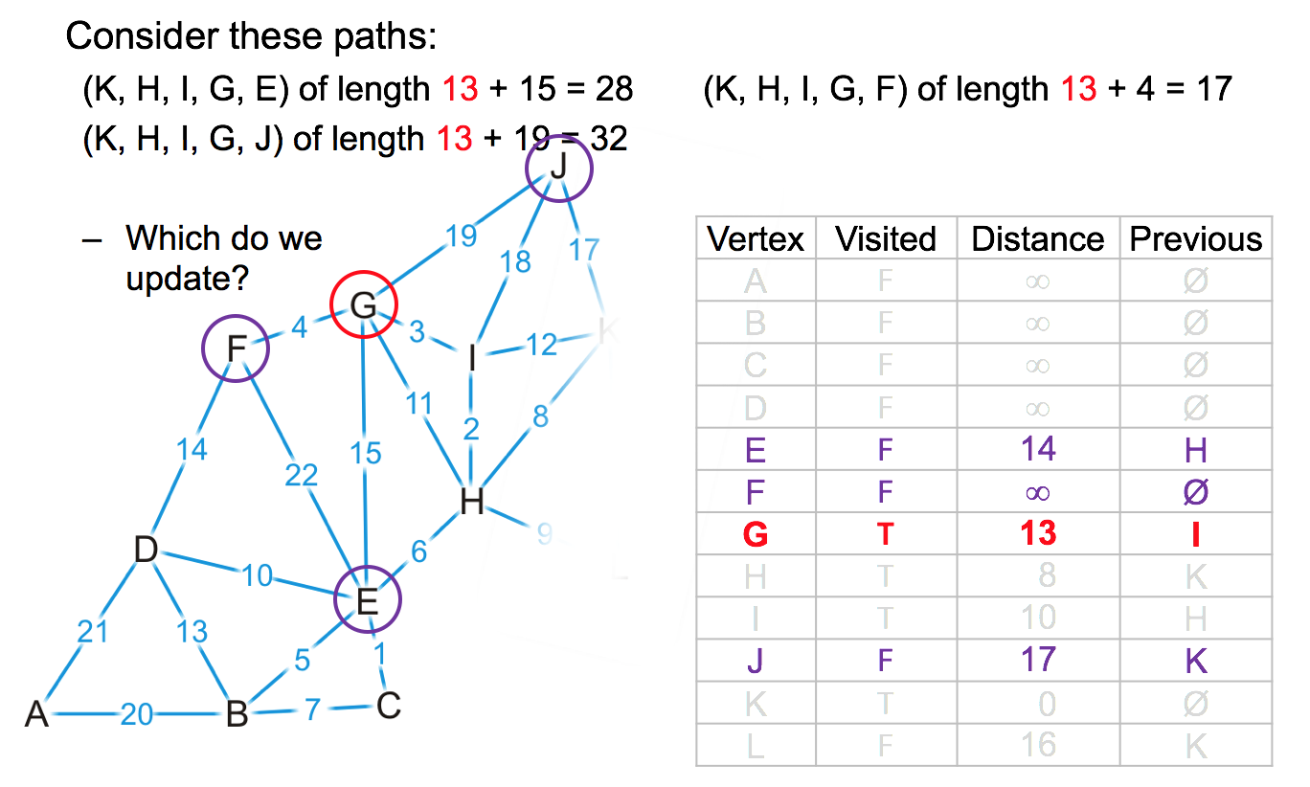
Example

Slide 42
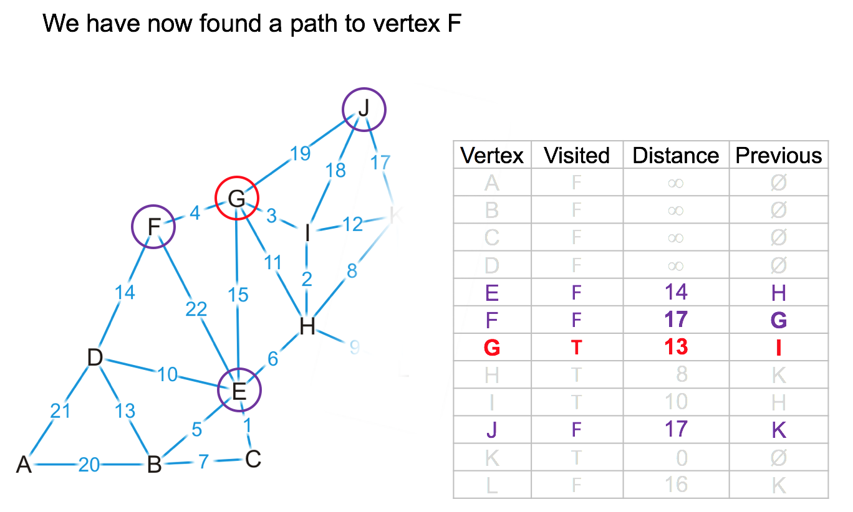
Example

Slide 43
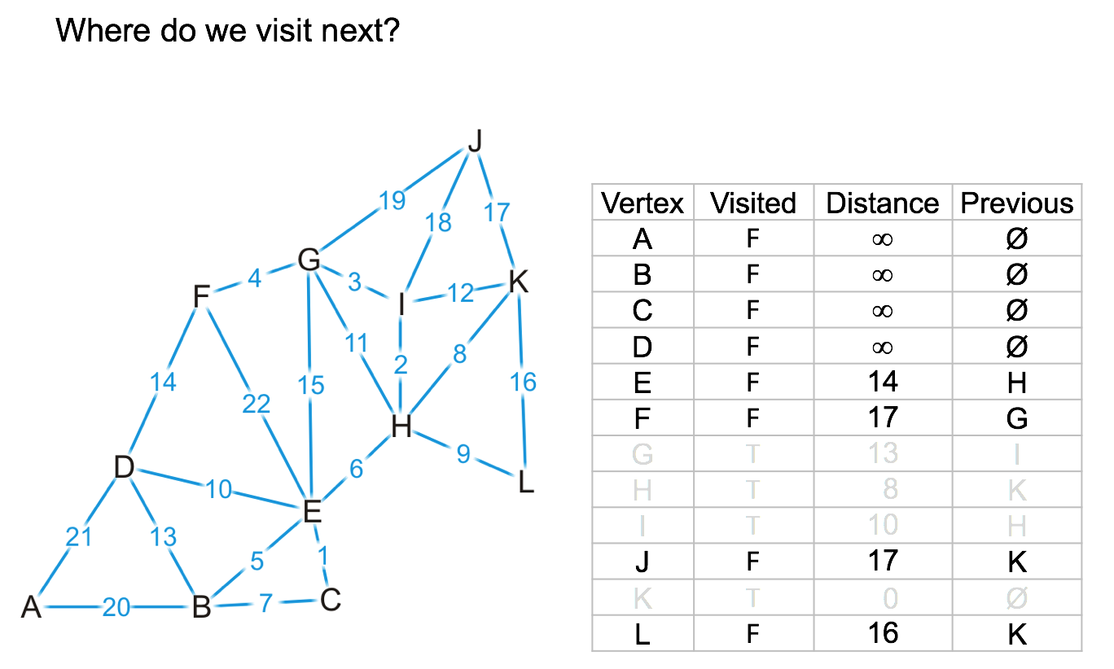
Example

Slide 44
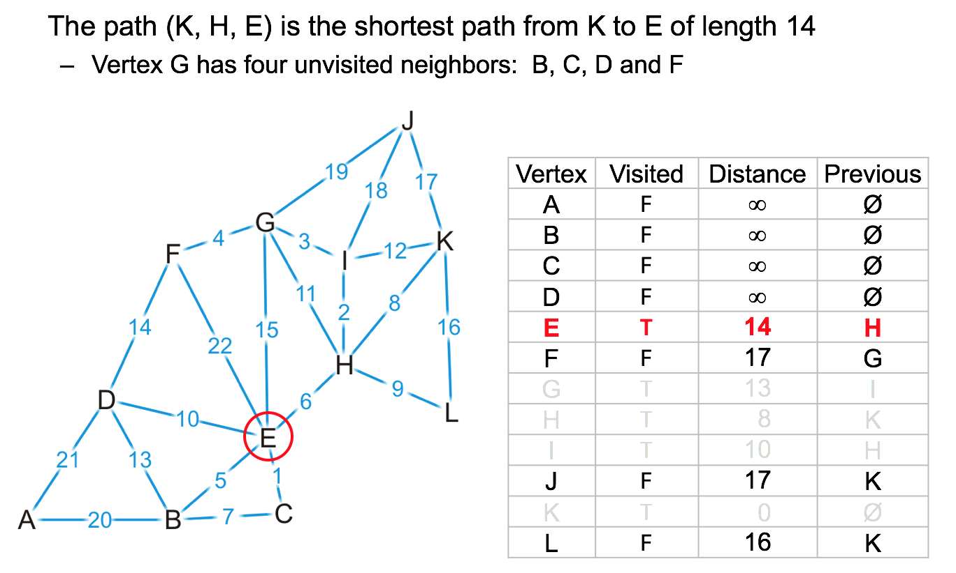
Example

Slide 45
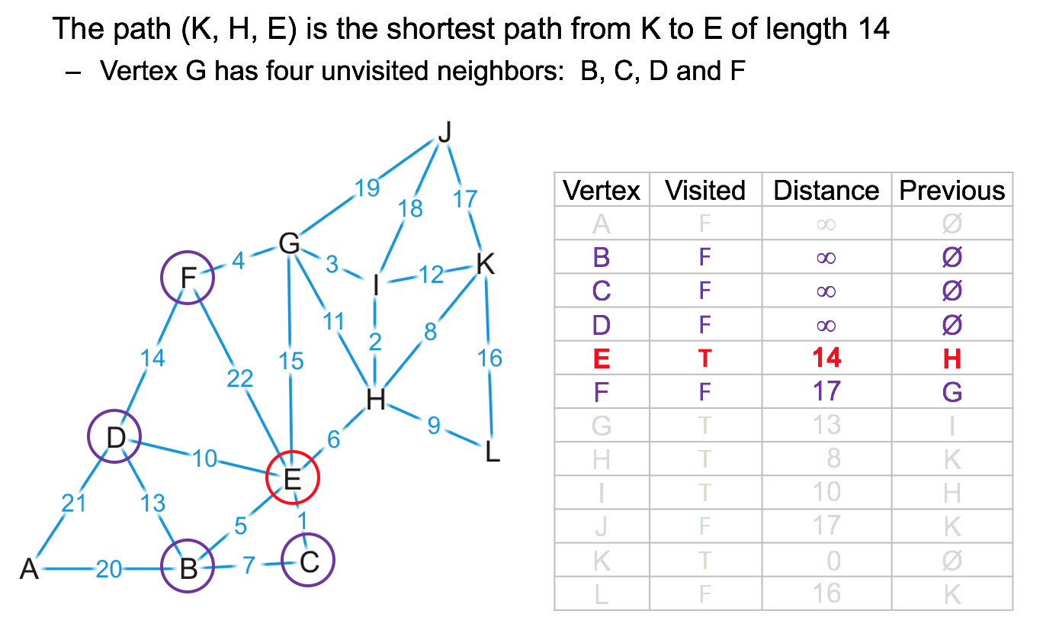
Example

Slide 46
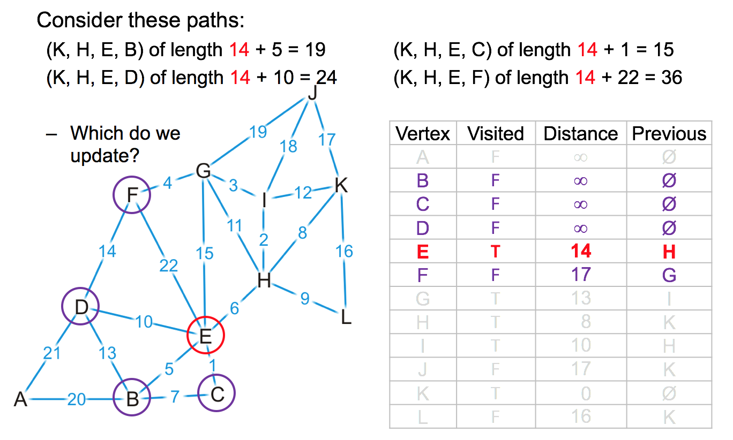
Example

Slide 47
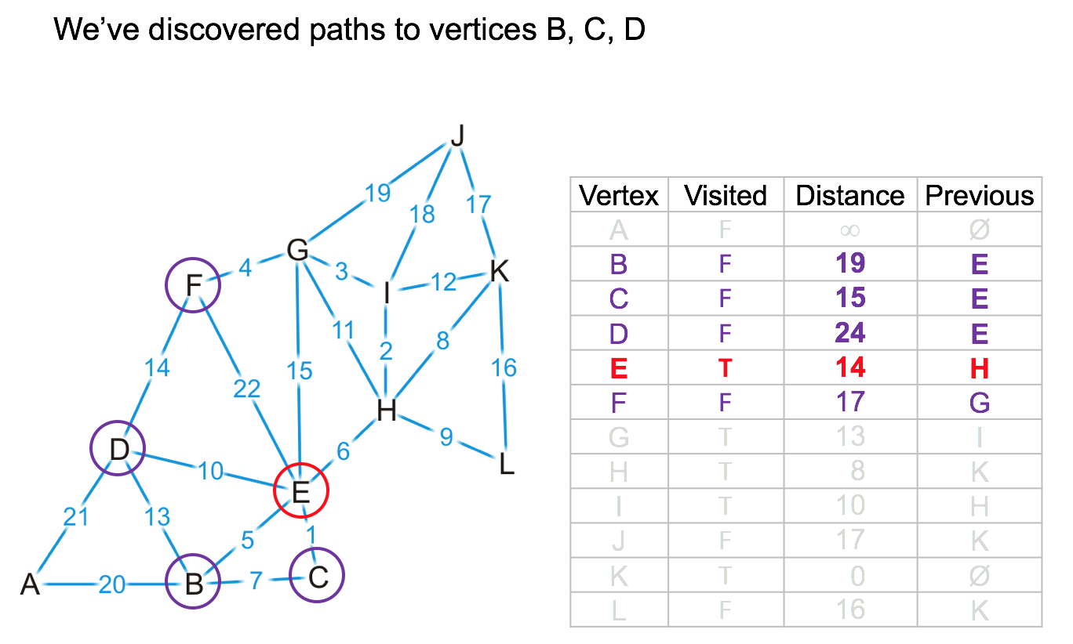
Example

Slide 48
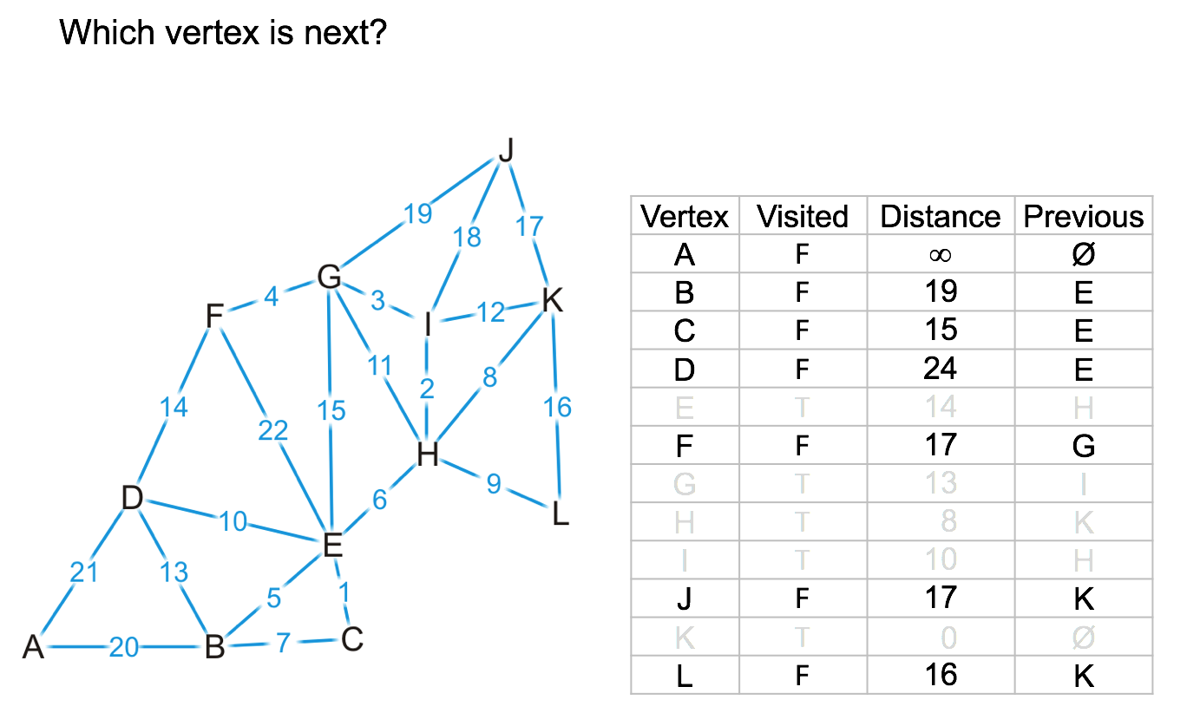
Example

Slide 49
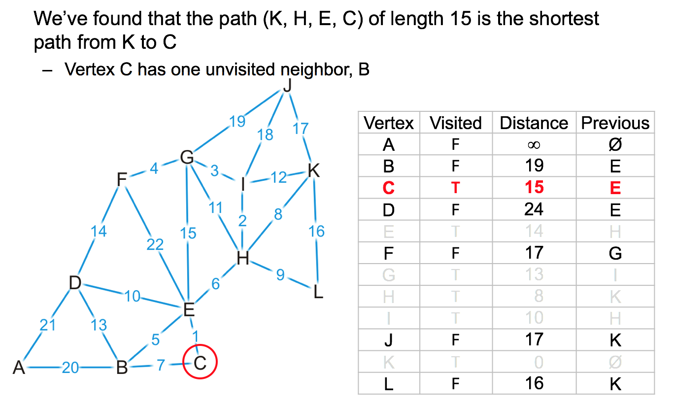
Example

Slide 50
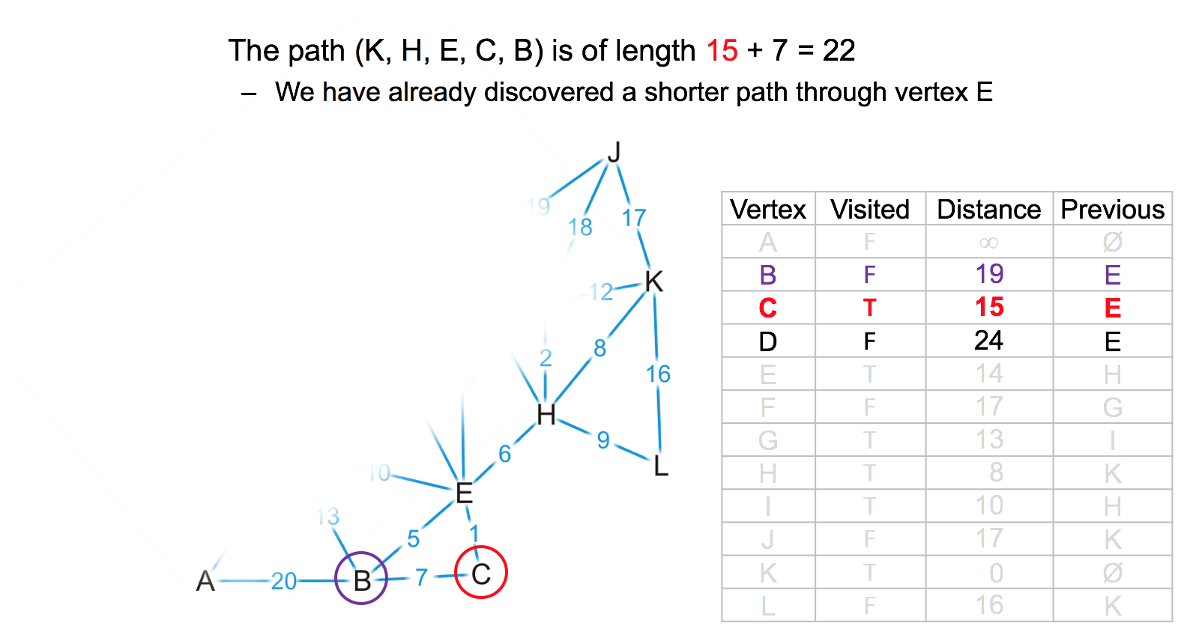
Example

Slide 51
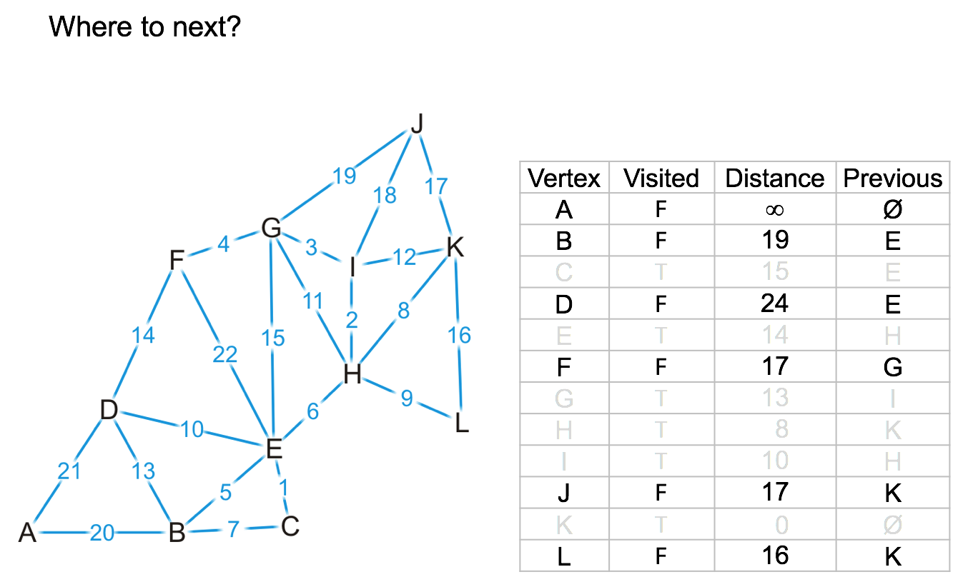
Example

Slide 52
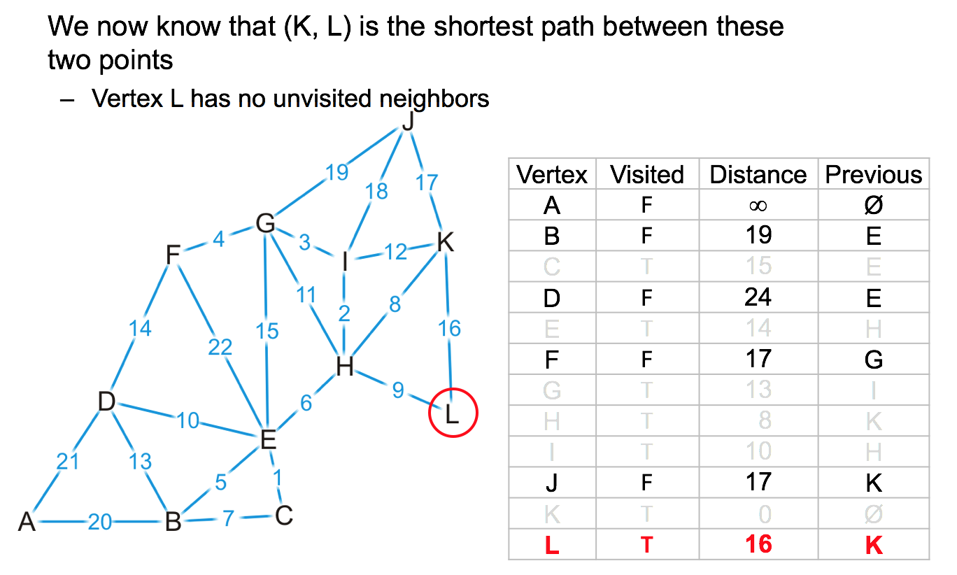
Example

Slide 53
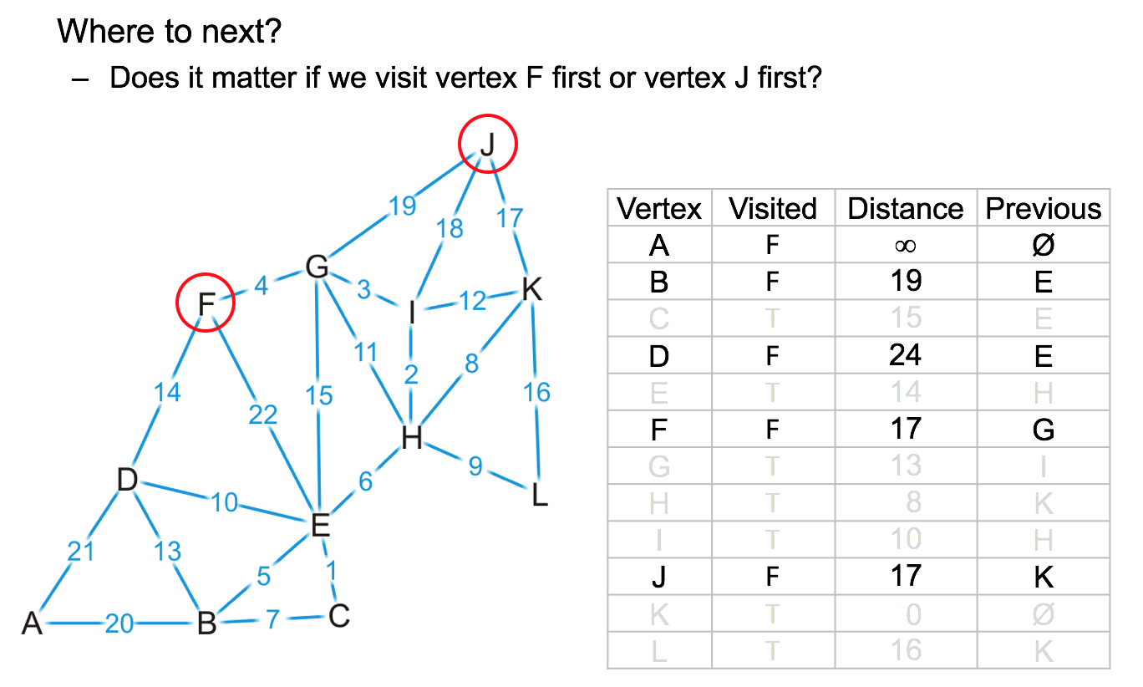
Example

Slide 54
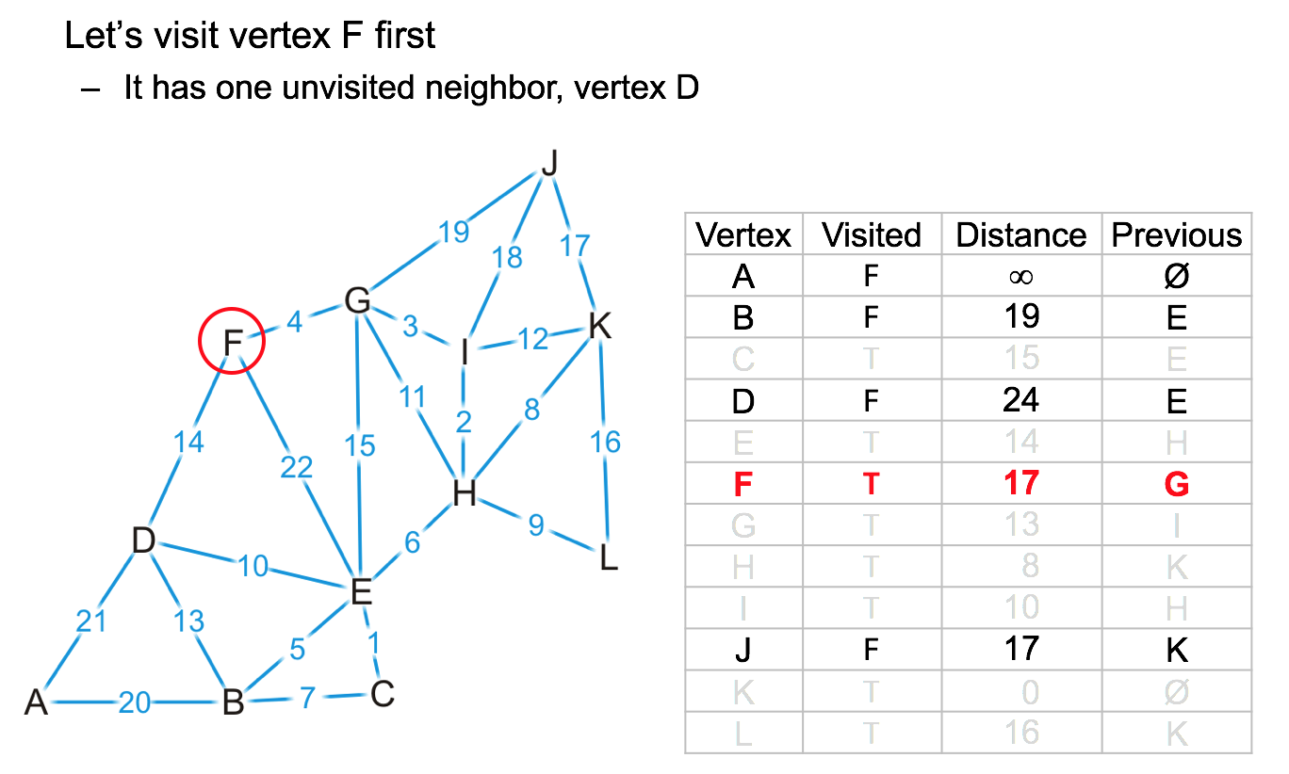
Example

Slide 55
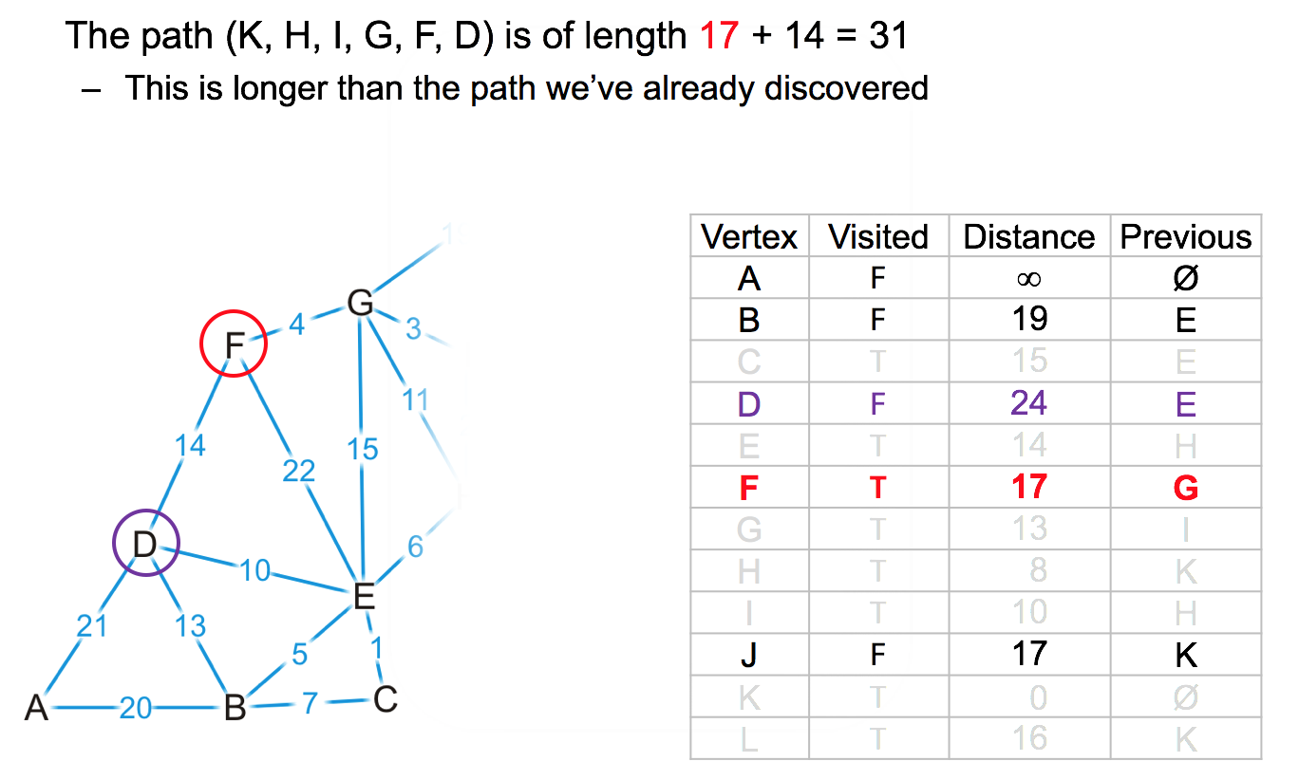
Example

Slide 56
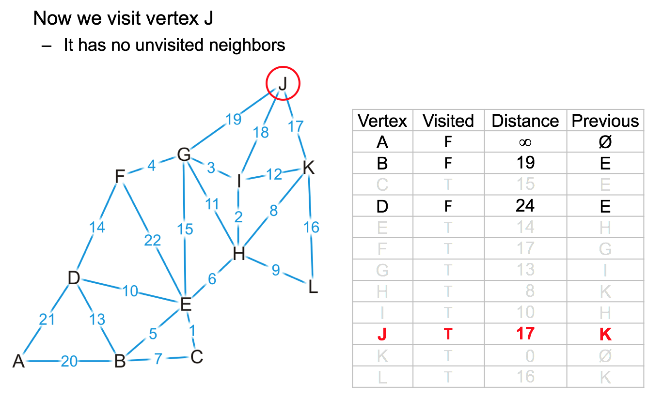
Example

Slide 57
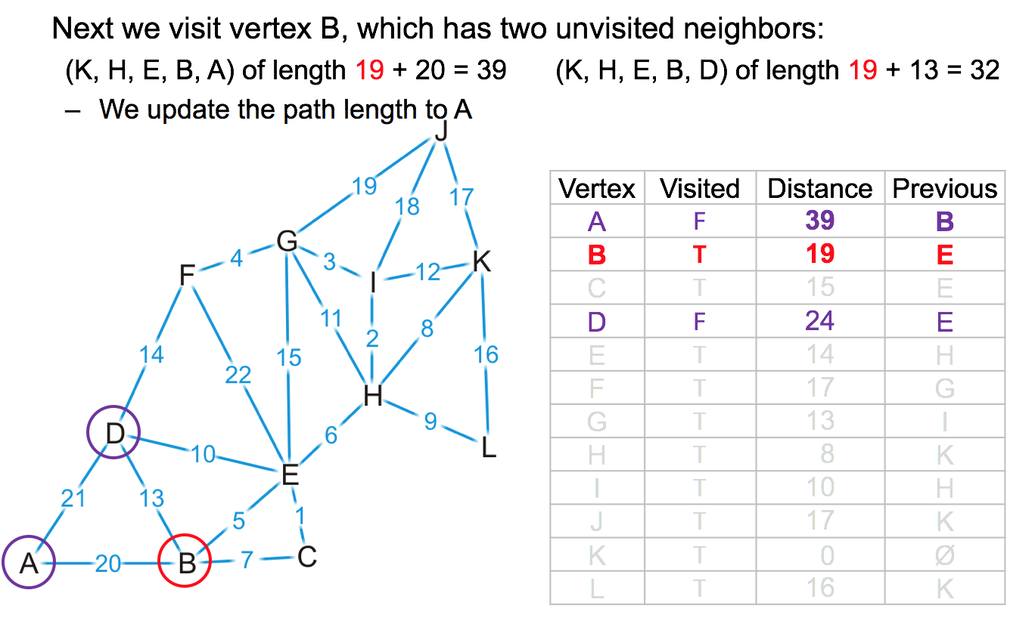
Example

Slide 58
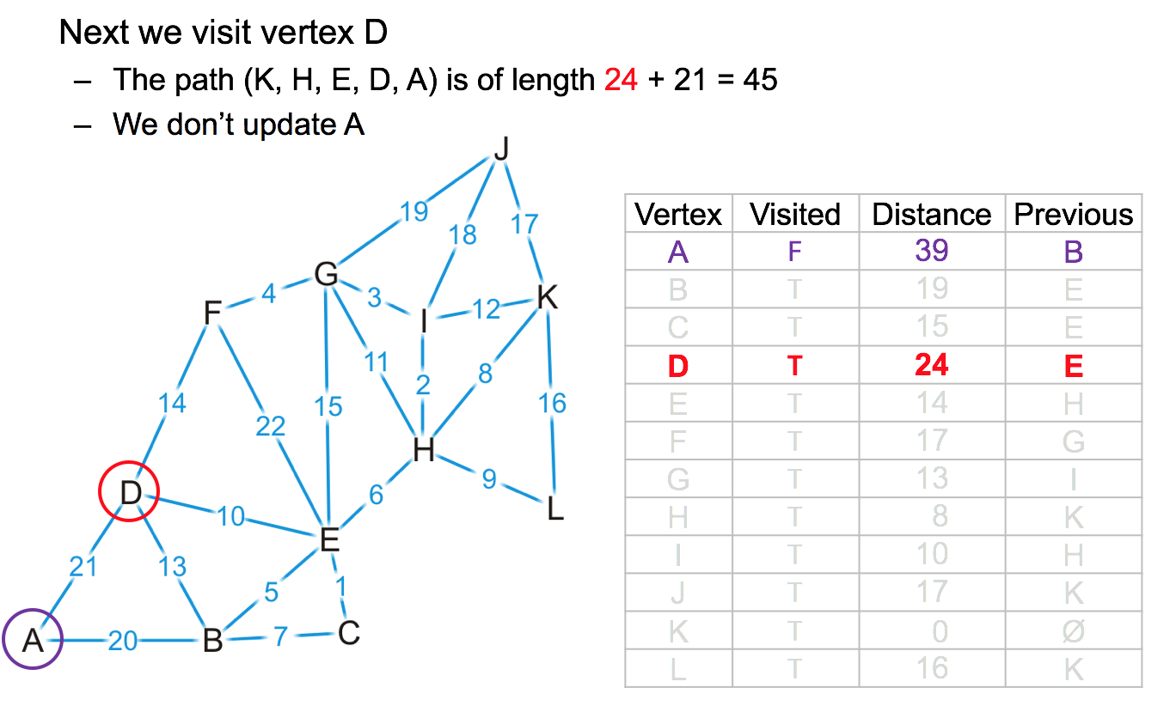
Example

Slide 59
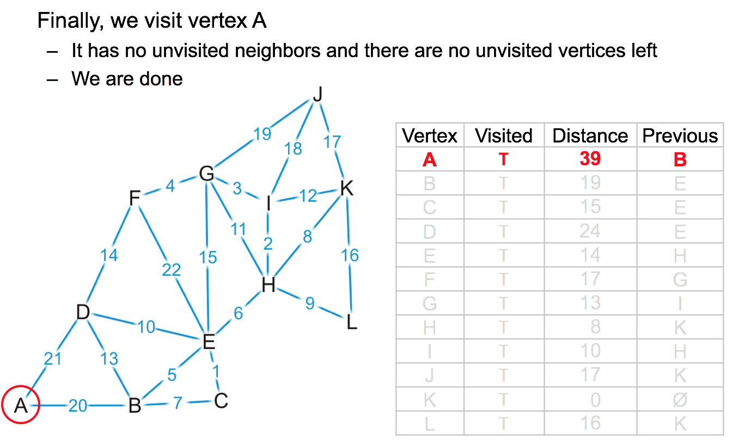
Example

Slide 60
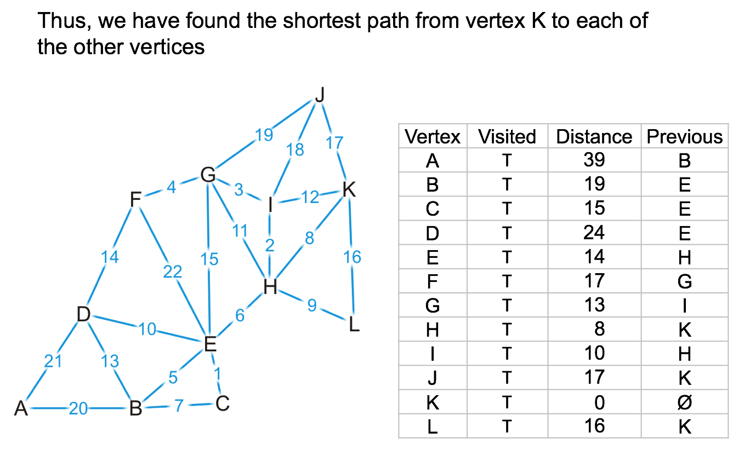
Example

Slide 61

Example

Slide 62

Example

Slide 63
Bellman Ford

Slide 64
Bellman Ford algorithm
Bellman Ford algorithm is another approach
Can work with negative weights
Idea
The algorithm checks whether there is a negative cycles, if yes, it will return false
The algorithm relax edges, progressively, decreasing an estimate v.d, until all V is done
The difference from Dijkstra is that Bellman Ford has a relaxation (recheck) mechanisms
By recheck everything, it makes sure that negative weights are put into consideration

Slide 65

Bellman Ford algorithm
Line 1: Define the source, and Initialize all distance from source to infinity (takes Θ(V) time
Line 2-4: Visit each vertex, for each vertex, scan possible route to neighbors, and update the distance to neighbors if the total distance (from source) is smaller (takes Θ(E) time)
Line 5-7: Check for a negative weight cycle
This algorithm takes Θ(VE) time since for every V, we perform a relaxation of edges E

Slide 66

Bellman Ford algorithm

Slide 68
Appendix: Tabular Version
Bellman Ford Algorithm
Credit: https://www.youtube.com/watch?v=obWXjtg0L64

Slide 69
Tabular version
Define the source
Initialize all distance from source to infinity
Visit each vertex, for each vertex, scan possible route to neighbors, and update the distance to neighbors if the total distance (from source) is smaller
Repeat 3, until no distance are being updated

Slide 70

Example
source: Michael Sambol

Slide 71

Example
Source: Michael Sambol

Slide 72

Example
Source: Michael Sambol

Slide 73

Example
Source: Michael Sambol

Slide 74

Example
Source: Michael Sambol

Slide 75

Example
Source: Michael Sambol

Slide 76

Example
Source: Michael Sambol

Slide 77

Example
Source: Michael Sambol

Slide 78

Example
Source: Michael Sambol

Slide 79

Example
Source: Michael Sambol

Slide 80

Example
Source: Michael Sambol

Slide 81

Example
Source: Michael Sambol

Slide 82

Example
Source: Michael Sambol

Slide 83

Example
Source: Michael Sambol

Slide 84

Example
Source: Michael Sambol

Slide 85

Example
Source: Michael Sambol

Slide 86

Example
Source: Michael Sambol

Slide 87
Example
Source: Michael Sambol

Slide 88

Example
Source: Michael Sambol

Slide 89

Example
Source: Michael Sambol

Slide 90

Example
Source: Michael Sambol

Slide 91

Example
Source: Michael Sambol

Slide 92
Example
Source: Michael Sambol

Slide 93

Example
No more change after the iteration means that the matrix is final

